Slide 1
DIGITAL TRANSMISSION
A computer network is designed to send information from one point to another. This information needs to be converted to either a digital signal or an analog signal for transmission.
First, digital-conversion techniques, methods which convert digital data to-digital digital signals.
Second, analog to- digital conversion techniques, methods which change an analog signal to a digital signaL
1. DIGITAL-TO-DIGITAL CONVERSION
2. ANALOG-TO-DIGITAL CONVERSION
DIGITAL-TO-DIGITAL CONVERSION
A. Line Coding
B. Block coding
C. Scrambling
2. ANALOG-TO-DIGITAL CONVERSION
A. Pulse Code Modulation
B. Delta Modulation.

Slide 2
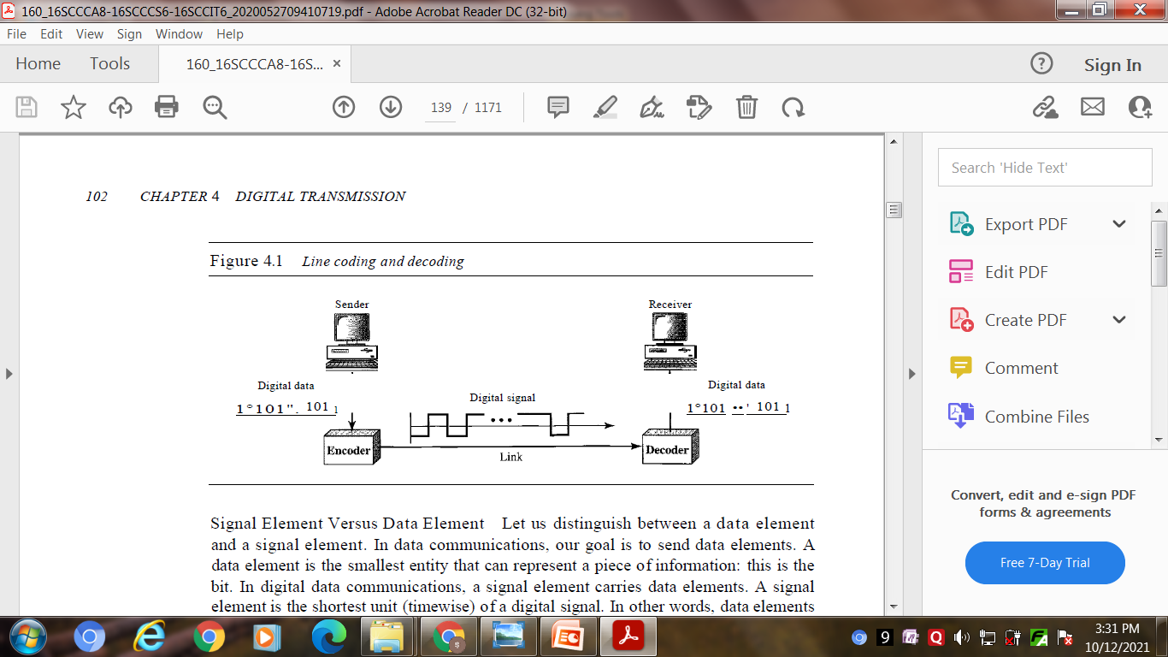
DIGITAL~TO~DIGITAL CONVERSION
A. Line Coding
Line coding is the process of converting digital data to digital signals. We assume that data, in the form of text, numbers, graphical images, audio, or video, are stored in computer memory as sequences of bits .
Line coding converts a sequence of bits to a digital signal. At the sender, digital data are encoded into a digital signal; at the receiver, the digital data are recreated by decoding the digital signal.

Slide 3
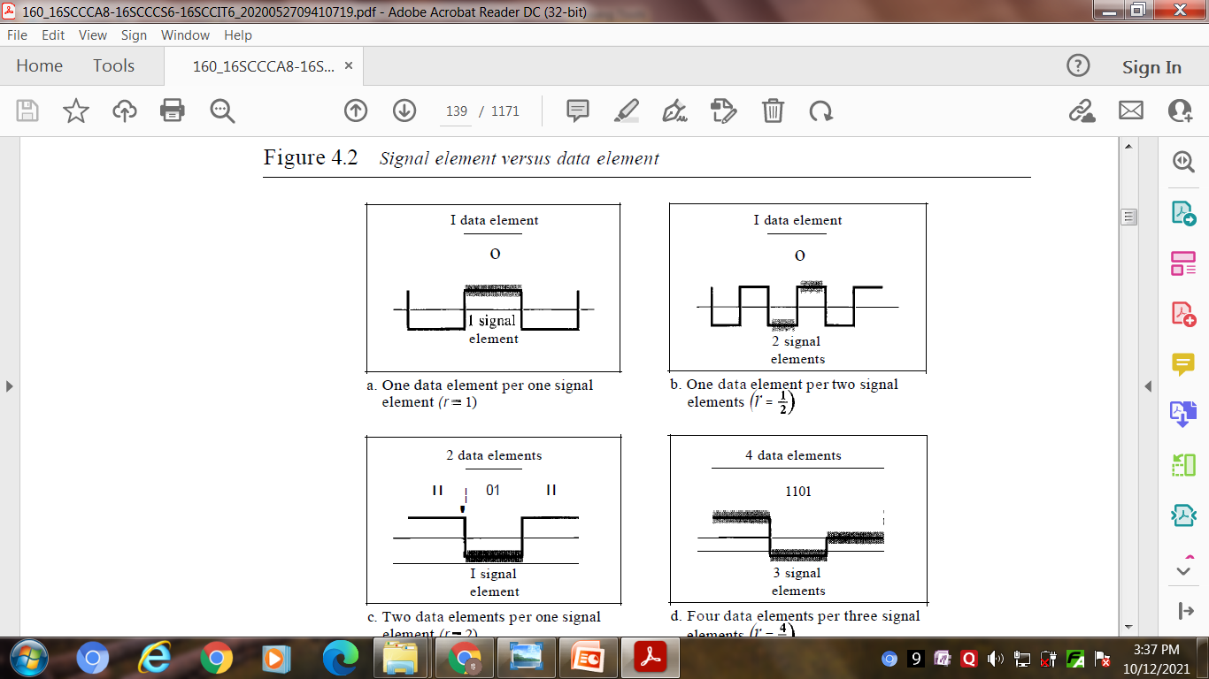
Characteristics
1. Signal Element Versus Data Element : data elements
are what we need to send; signal elements are what we can send. Data elements are being carried; signal elements are the carriers.
2. Data Rate Versus Signal Rate :
The data rate defines the number of
data elements (bits) sent in Is. The
unit is bits per second (bps). The
signal rate is the number of signal elements sent in Is. The unit is the baud. The data rate is sometimes called the bit rate; the signal rate is sometimes called the pulse rate, the modulation rate, or the baud rate.
3. Baseline Wandering In decoding a digital signal, the receiver calculates a running average of the received signal power. This average is called the baseline. The incoming signal power is evaluated against this baseline to determine the value of the data element. A long string of Os or 1s can cause a drift in the baseline (baseline wandering) and make it difficult for the receiver to decode correctly.

Slide 4
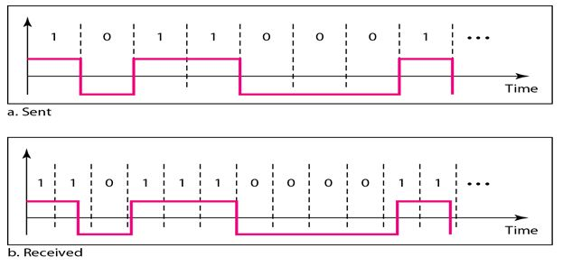
4. DC Components : When the voltage level in a digital signal is constant for a while,
the spectrum creates very low frequencies (results of Fourier analysis). These frequencies around zero, called DC (direct-current) components.
5. Self-synchronization : A self-synchronizing digital signal includes timing information in the data being transmitted. This can be achieved if there are transitions in the signal that alert the receiver to the beginning, middle, or end of the pulse. If the receiver's clock is out of synchronization, these points can reset the clock.

Slide 5
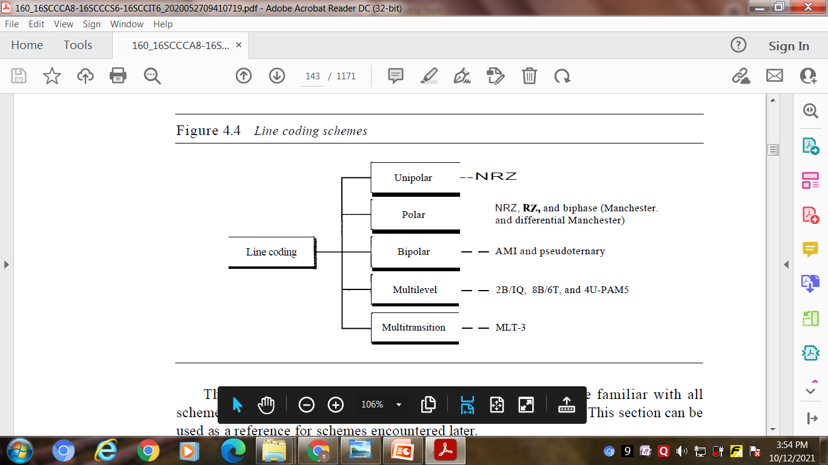
6. Built-in Error Detection : It is desirable to have a built-in error-detecting capability
in the generated code to detect some of or all the errors that occurred during transmission. Some encoding schemes that we will discuss have this capability to some extent.
7. Immunity to Noise and Interference : Another desirable code characteristic is a code that is immune to noise and other interferences
8. Complexity : A complex scheme is more costly to implement than a simple one. For
example, a scheme that uses four signal levels is more difficult to interpret than one that uses only two levels.
Line Coding Schemes

Slide 6
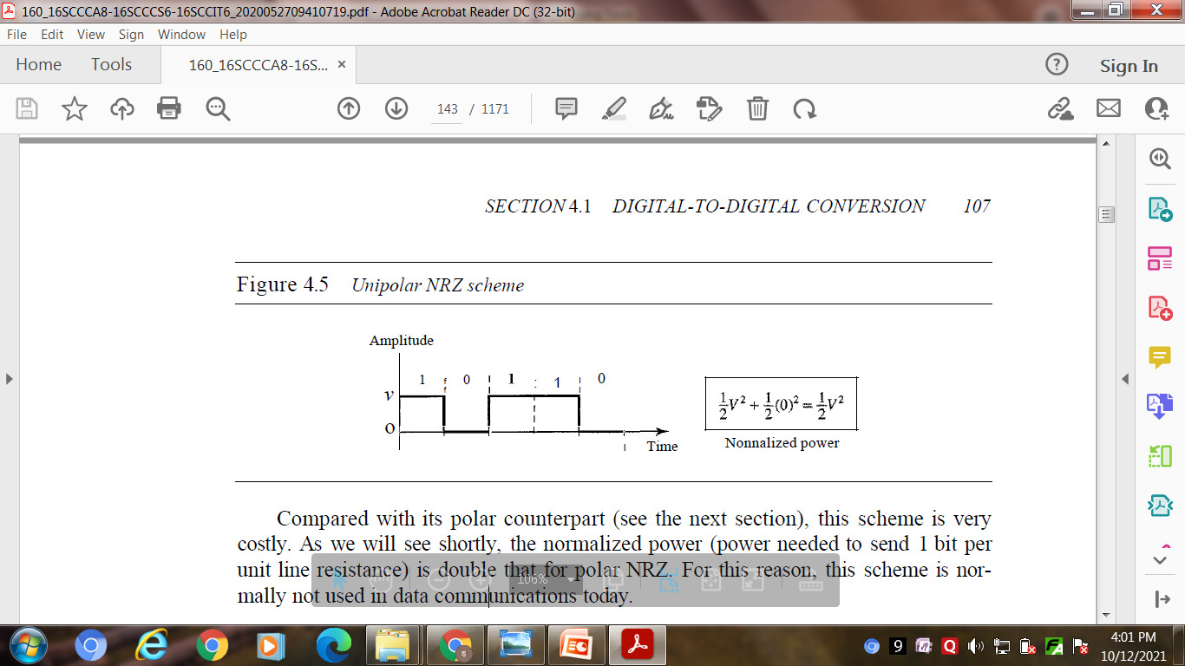
Unipolar Scheme:
In a unipolar scheme, all the signal levels are on one side of the time axis, either above or below.
NRZ (Non-Return-to-Zero) : Traditionally, a unipolar scheme was designed as a non-return-to-zero (NRZ) scheme in which the positive voltage defines bit 1 and the zero voltage defines bit 0. It is called NRZ because the signal does not return to zero at the middle of the bit.
2. Polar Schemes :
In polar schemes, the voltages are on the both sides of the time axis. For example, the
voltage level for 0 can be positive and the voltage level for 1 can be negative.
Non-Return-to-Zero (NRZ) In polar NRZ encoding, we use two levels of voltage
amplitude. We can have two versions of polar NRZ: NRZ-Land NRZ-I. In NRZ-L the level of the voltage determines the value of the bit. In NRZ-I the inversion or the lack of inversion determines the value of the bit.

Slide 7
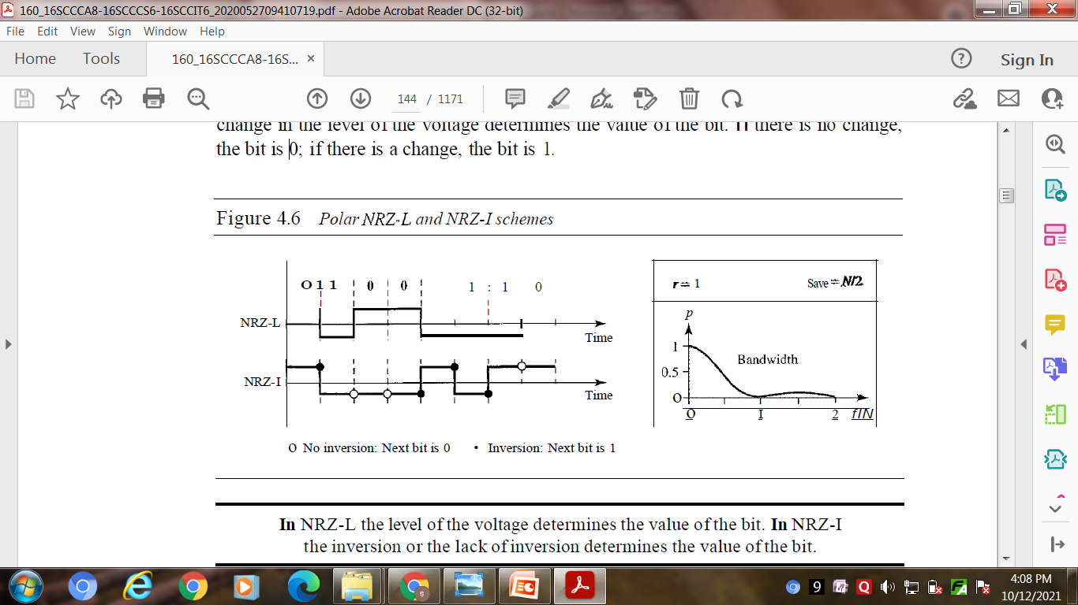
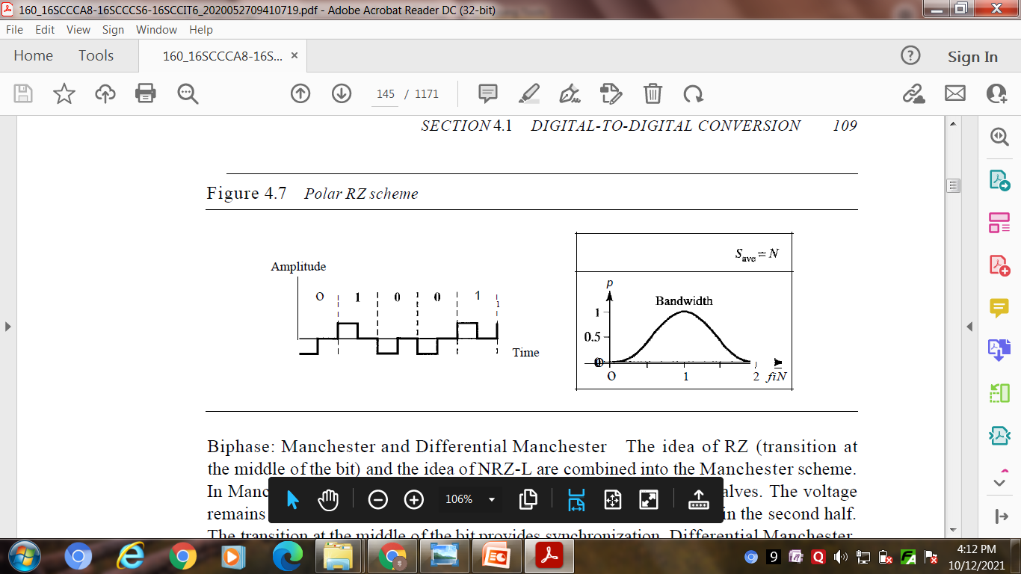
Return to Zero (RZ)
the return-to-zero (RZ) scheme, which uses three values: positive, negative, and zero. In RZ, the signal changes not between bits but during the bit.

Slide 8
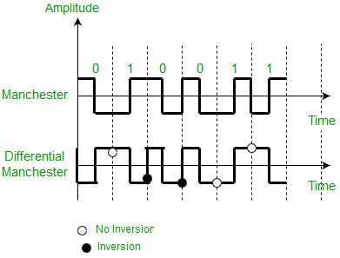
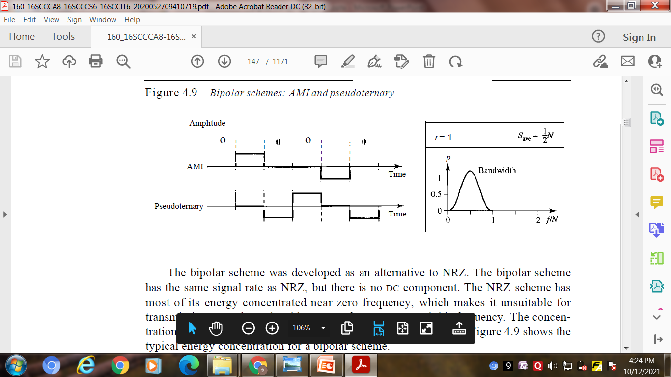
Biphase: Manchester and Differential Manchester
In Manchester and differential Manchester encoding, the transition at the middle of the bit is used for synchronization.
3. Bipolar Schemes
In bipolar encoding (sometimes called
multilevel binary), there are three voltage levels: positive, negative, and zero.
AMI and Pseudoternary : A common bipolar encoding scheme is called bipolar alternate mark inversion (AMI). AMI means alternate 1 inversion. A neutral zero voltage represents binary 0. Binary 1s are represented by alternating positive and negative voltages. A variation of AMI encoding is called pseudoternary in which the 1 bit is encoded as a zero voltage and the 0 bit is encoded as alternating positive and negative voltages.

Slide 9
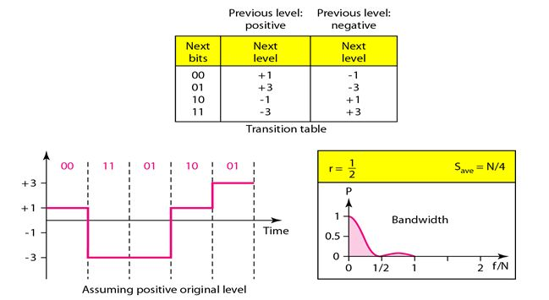
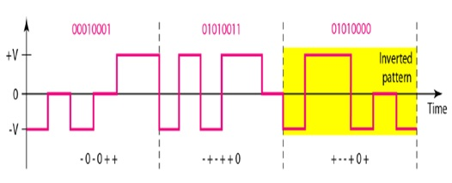
4. Multilevel Schemes :
The desire to increase the data speed or decrease the required bandwidth has resulted in the creation of many schemes. The goal is to increase the number of bits per baud by encoding a pattern of m data elements into a pattern of n signal elements.
2BlQ : The average signal rate of
2BlQ is S =N/4. This means that using
2BIQ, we can send data 2 times faster
than by using NRZ-L.
8B6T : A very interesting scheme is
eight binary, six ternary (8B6T). This
code is used with 100BASE-4T cable, as we will see in Chapter 13. The idea is to encode a pattern of 8 bits as a
pattern of 6 signal elements, where
the signal has three levels (ternary).

Slide 10
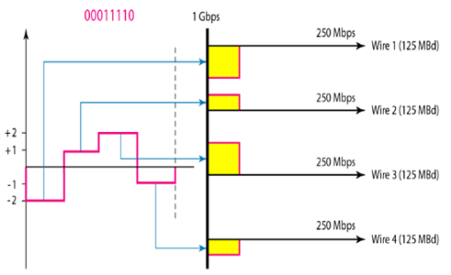
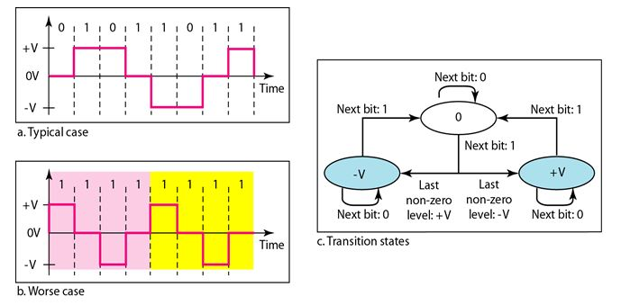
4D-PAM5: The last signaling scheme we discuss in this category is called four dimensional five-level pulse amplitude modulation (4D-PAM5). The 4D means that data is sent over four wires at the same time. It uses five voltage levels, such as -2, -1, 0, 1, and 2.
5. Multiline Transmission: MLT-3
The multiline transmission, three level (MLT-3) scheme uses three levels (+v, 0, and - V) and three transition rules to move between the levels.
1. If the next bit is 0, there is no transition.
2. If the next bit is 1 and the current level is not 0, the next level is 0.
3. If the next bit is 1 and the cutTent level is 0, the next level is the opposite of the last nonzero level.

Slide 11
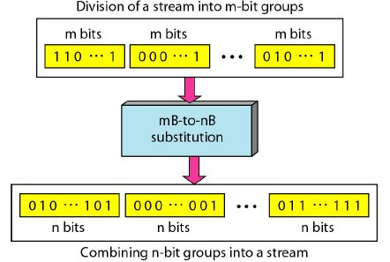
B. Block Coding
We need redundancy to ensure synchronization and to provide some kind of inherent error detecting. Block coding can give us this redundancy and improve the performance of line coding. In general, block coding changes a block of m bits into a block of n bits, where n is larger than m. Block coding is referred to as an mB/nB encoding technique.
Block coding is normally referred to as mBlnB coding;
it replaces each m~bit group with an n~bit group.

Slide 12
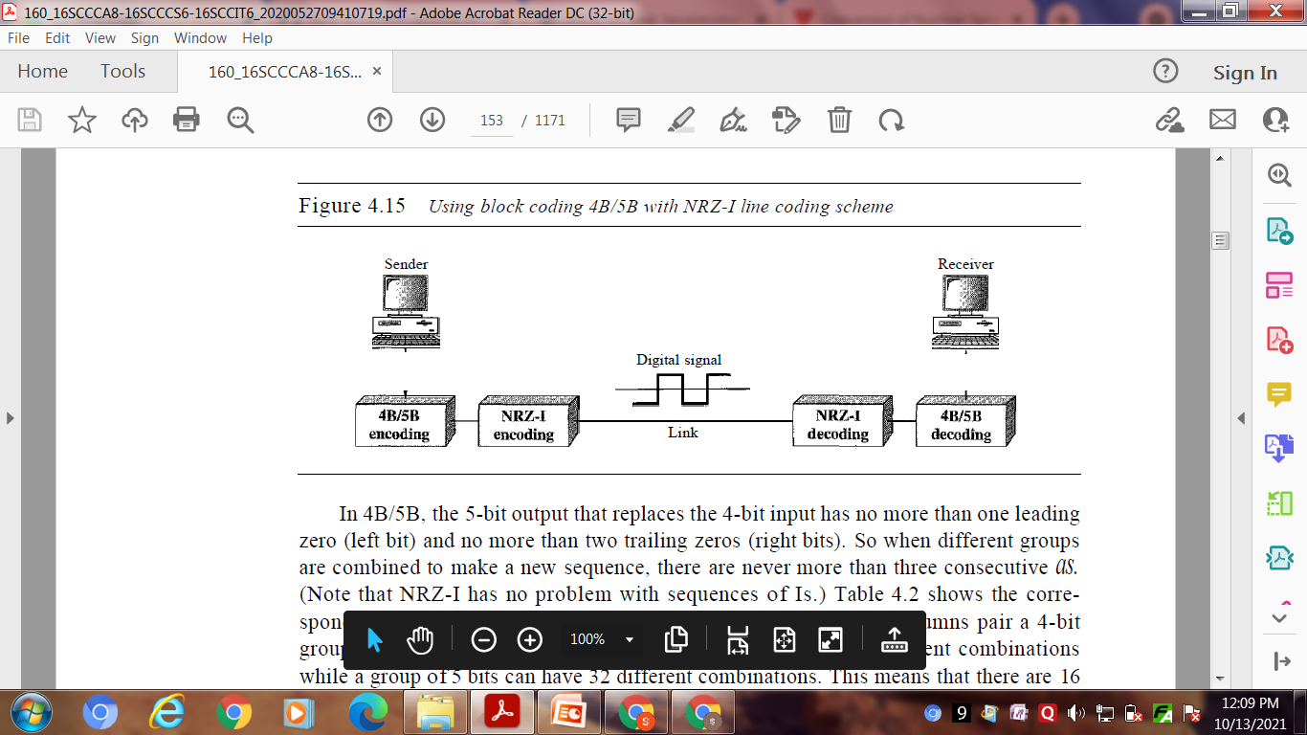
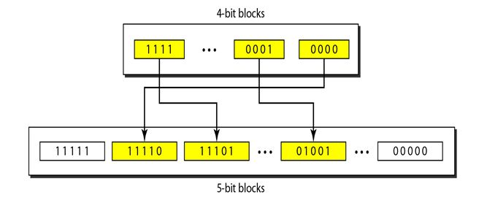
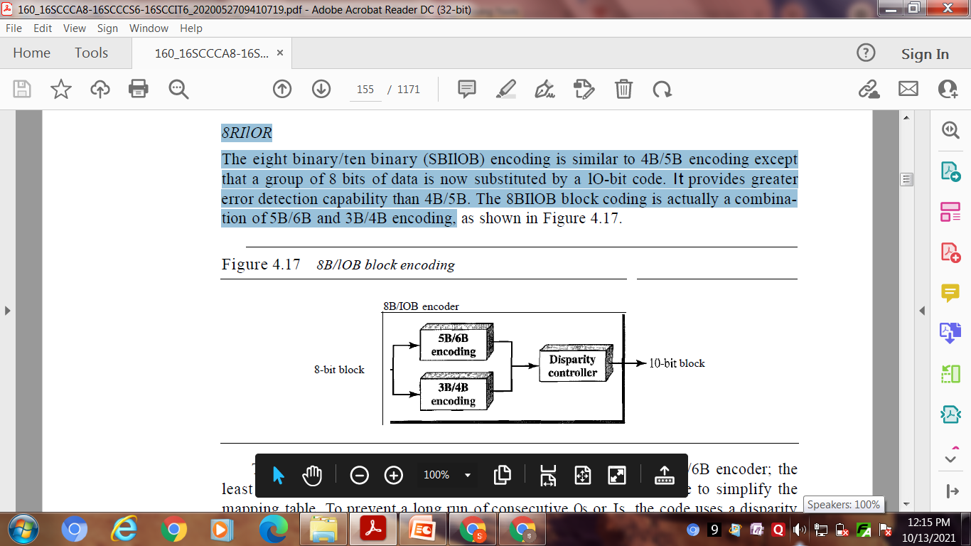
4B/5B :
The four binary/five binary (4B/5B) coding scheme was designed to be used in combination with NRZ-I. NRZ-I has a good signal rate, one-half that of the
Biphase , but it has a synchronization problem. The block-coded stream does not have more that three consecutive 0s. At the receiver, the NRZ-I encoded digital signal is first decoded into a stream of bits and then decoded to remove the redundancy.
8B/10B :
The eight binary/ten binary (8B/10B) encoding is similar to 4B/5B encoding except that a group of 8 bits of data is now substituted by a lO-bit code. It provides greater error detection capability than 4B/5B. The 8BIlOB block coding is actually a combination of 5B/6B and 3B/4B encoding.

Slide 13
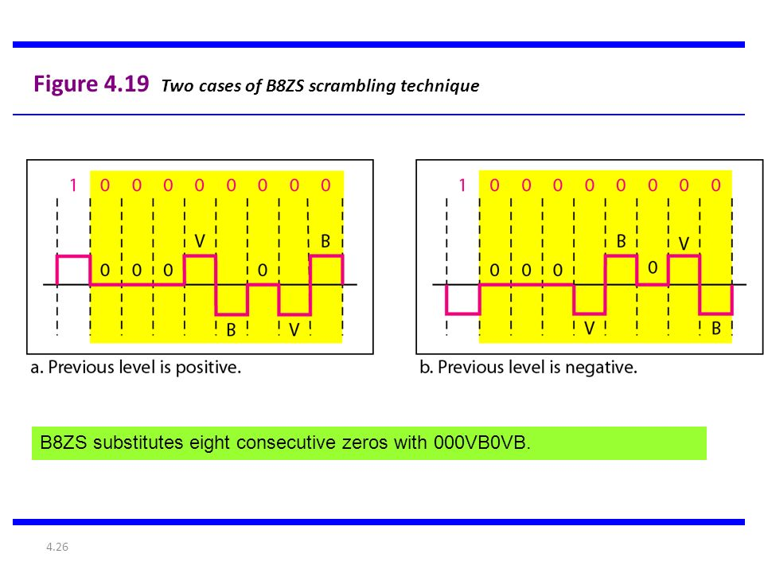
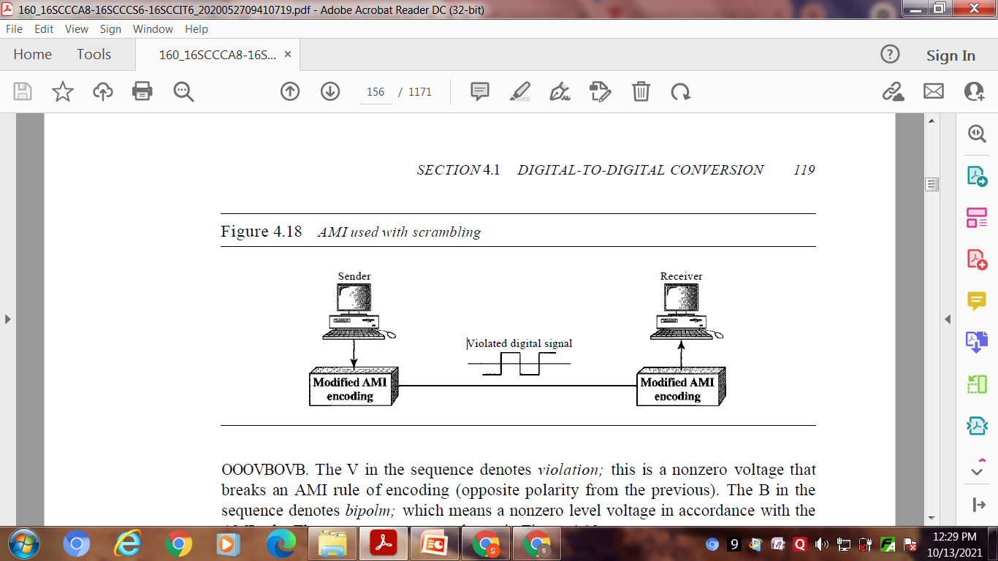
C. Scrambling :
scrambling, as opposed to block coding, is done at the same time as encoding. The system needs to insert the required pulses based on the defined scrambling rules. Two common scrambling techniques are B8ZS and HDB3.
B8ZS
Bipolar with S-zero substitution (BSZS) is commonly used in North America. In this technique, eight consecutive zero-level voltages are replaced by the sequence 000VB0VB. The V in the sequence denotes violation; this is a nonzero voltage that breaks an AMI rule of encoding (opposite polarity from the previous). The B in the sequence denotes bipolm; which means a nonzero level voltage in accordance with the AMI rule.

Slide 14
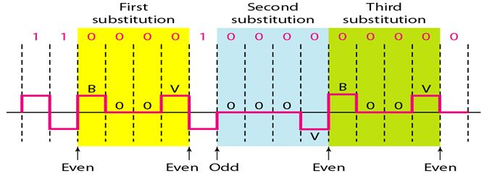
HDB3 :
High-density bipolar 3-zero (HDB3) is commonly used outside of North America. In this technique, which is more conservative than B8ZS, four consecutive zero-level voltages are replaced with a sequence of 000V or B00V The reason for two different substitutions is to maintain the even number of nonzero pulses after each substitution.

Slide 15
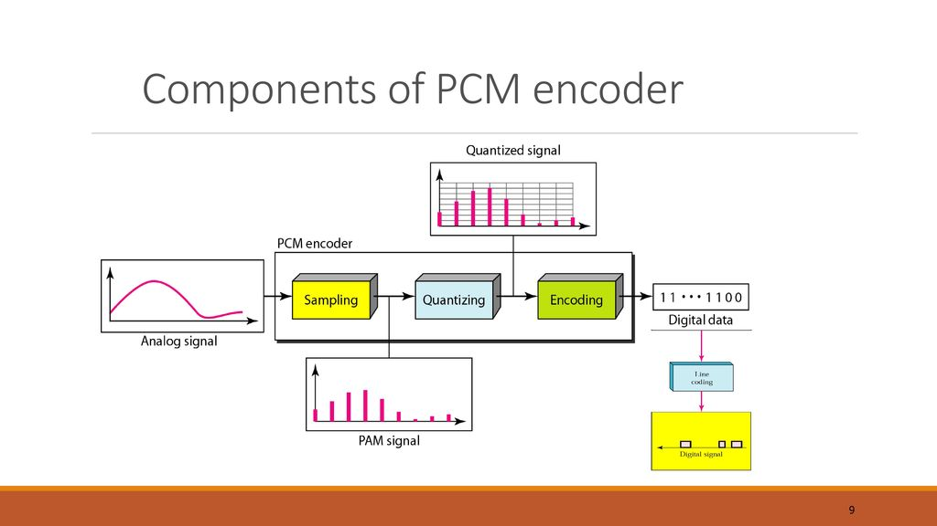
2. ANALOG-TO-DIGITAL CONVERSION
we have an analog signal such as one created by a microphone or camera.
A. Pulse Code Modulation And
B. Delta Modulation.
A. Pulse Code Modulation
The most common technique to change an analog signal to digital data (digitization) is called pulse code modulation (PCM). A PCM encoder has three processes
1. The analog signal is sampled.
2. The sampled signal is quantized.
3. The quantized values are encoded as streams of bits.

Slide 16
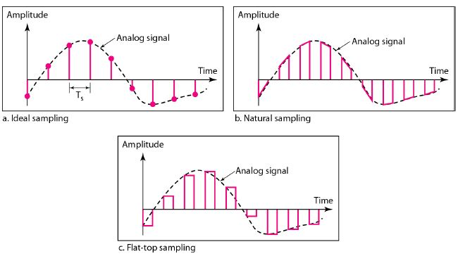
Sampling
The first step in PCM is sampling. The analog signal is sampled every Ts s, where Ts is the sample interval or period. The inverse of the sampling interval is called the sampling rate or sampling frequency and denoted by fs, where fs = 1/Ts' There are three sampling methods-ideal, natural, and flat-top.
The sampling process is sometimes referred to as pulse amplitude modulation
(PAM).

Slide 17
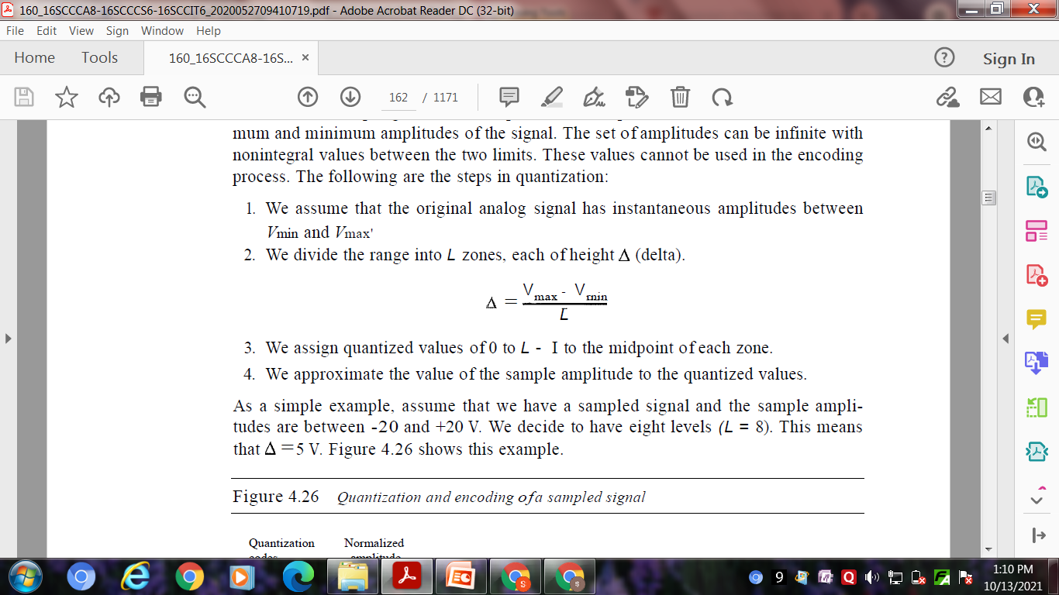
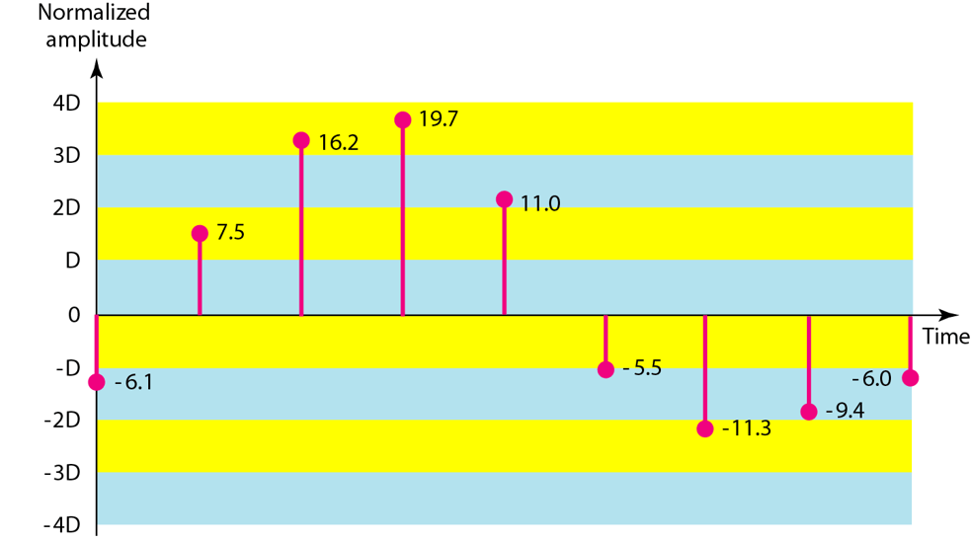
2) Quantization
The result of sampling is a series of pulses with amplitude values between the maximum and minimum amplitudes of the signal.
Quantization Levels L :
the number of levels, depends on
the range of the amplitudes of the
analog signal and how
accurately we need to recover
the signal.
Quantization Error : The quantization error changes the signal-to-noise ratio of the signal, which in turn reduces the upper limit capacity according to Shannon.
Uniform Versus Non uniform Quantization :For many applications, the distribution of the instantaneous amplitudes in the analog signal is not uniform. the height of delta is not fixed; it is greater near the lower amplitudes and less near the higher amplitudes. Non uniform quantization can also be achieved by using a process called companding and expanding

Slide 18
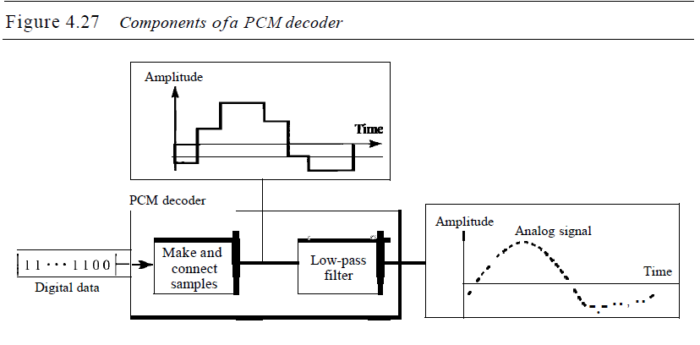

3) Encoding :
The last step in PCM is encoding. After each sample is quantized and the number of bits per sample is decided, each sample can be changed to an nb-bit code word.
Bit rate = sampling rate X number of bits per sample=fs X nb
Original Signal Recovery
The recovery of the original signal
requires the PCM decoder. The
decoder first uses circuitry to
convert the code words into a pulse
that holds the amplitude until the
next pulse. After the staircase
signal is completed, it is passed
through a low-pass filter to smooth
the staircase signal into an analog signal.
PCM Bandwidth
Suppose we are given the bandwidth of a low-pass analog signal.
This means the minimum bandwidth of the digital signal is nb times greater than the bandwidth of the analog signal. This is the price we pay for digitization.

Slide 19
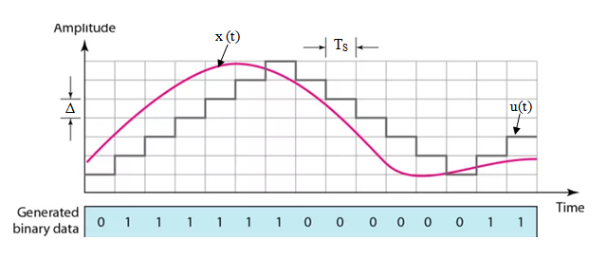
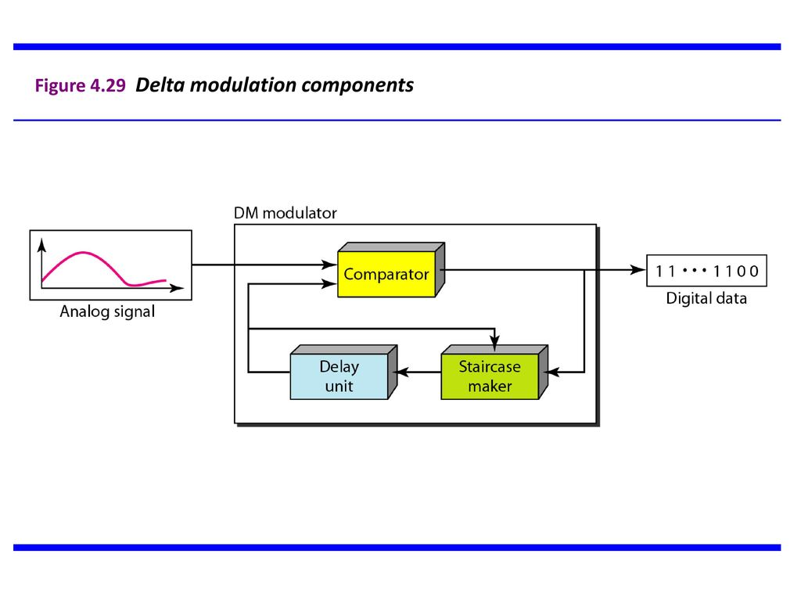
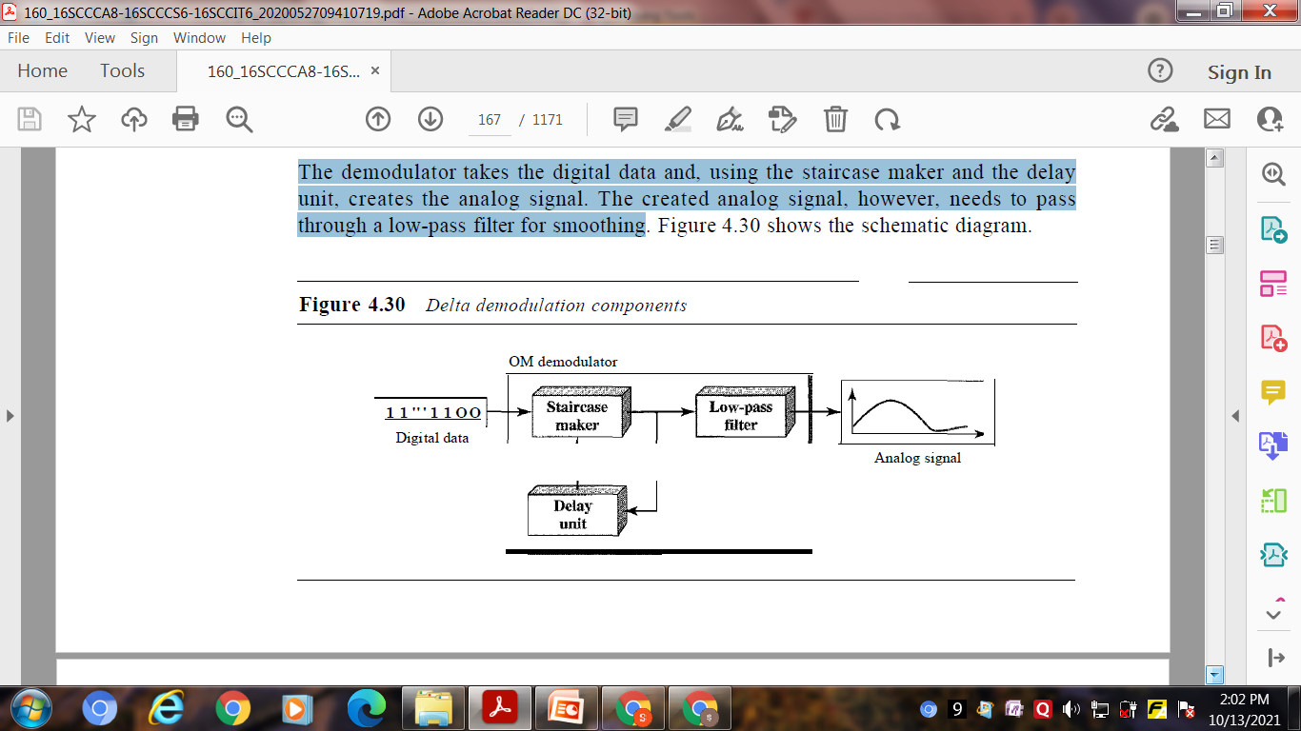
B. Delta Modulation(DM):
PCM is a very complex technique. Other techniques have been developed to reduce the complexity of PCM. The simplest is delta modulation. PCM finds the value of the signal amplitude for each sample;
Modulator : The modulator is used at the sender site to create a stream of bits from an analog signal. The process records the small positive or negative changes, called delta . If the delta is positive, the process records a 1; if it is negative, the process records a 0.
2) Demodulator : The demodulator takes the digital data and, using the staircase maker and the delay unit, creates the analog signal. The created analog signal, however, needs to pass
through a low-pass filter for smoothing

Slide 20
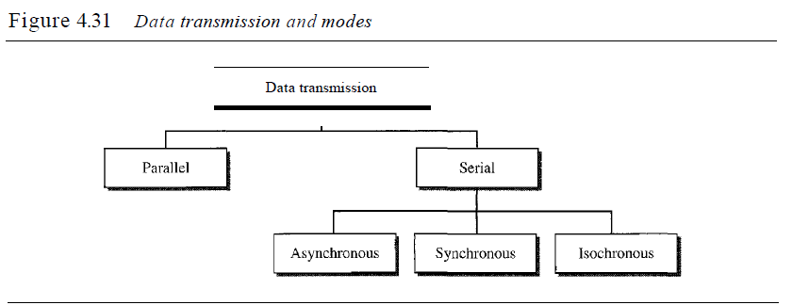
3) Adaptive DM
A better performance can be achieved if the value of 0 is not fixed. In adaptive delta modulation, the value of 0 changes according to the amplitude of the analog signal.
4) Quantization Error
It is obvious that DM is not perfect. Quantization error is always introduced in the process. The quantization error of DM, however, is much less than that for PCM.
TRANSMISSION MODES

Slide 21
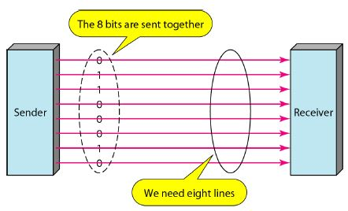
1.Parallel Transmission
Binary data, consisting of 1s and 0s, may be organized into groups of n bits each. By grouping, we can send data n bits at a time instead of 1. This is called parallel transmission. The mechanism for parallel transmission is a conceptually simple one: Use n wires to send n bits at one time. That way each bit has its own wire, and all n bits of one group can be transmitted with each clock tick from one device to another. the eight wires are bundled in a cable with a connector at each end. The advantage of parallel transmission is speed. All else being equal, parallel transmission can increase the transfer speed by a factor of n over serial transmission. But there is a significant disadvantage: cost. Parallel transmission requires n communication lines (wires in the example) just to transmit the data stream. Because this is expensive, parallel transmission is usually limited to short distances.

Slide 22
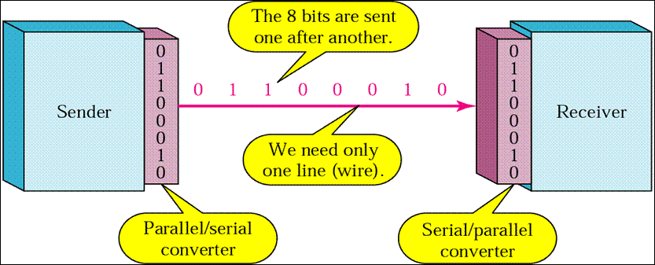
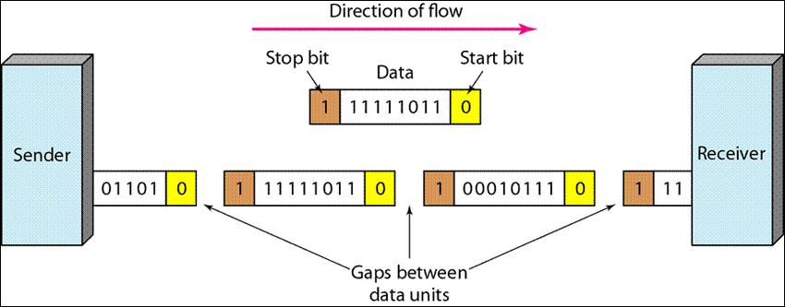
2. Serial Transmission
In serial transmission one bit follows another, so we need only one communication channel rather than n to transmit data between two communicating devices The advantage of serial over parallel transmission is that with only one communication
channel, serial transmission reduces the cost of transmission over parallel by roughly a factor of n. Serial transmission occurs in one of three ways: asynchronous, synchronous, and isochronous.
A. Asynchronous Transmission : In asynchronous transmission, we send 1 start bit (0) at the beginning and 1 or more stop bits (1s) at the end of each byte. There may be a gap between each byte. Asynchronous here means "asynchronous at the byte level;‘ But the bits are still synchronized; their durations are the same.

Slide 23
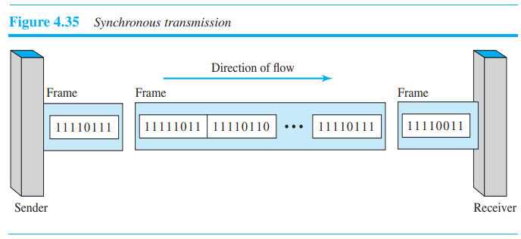
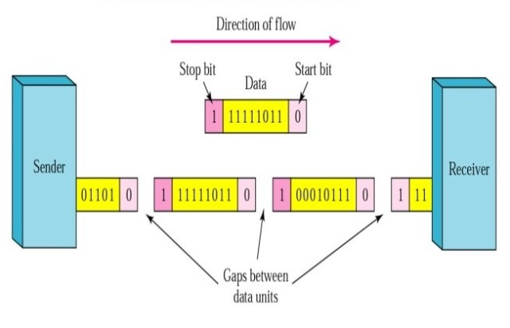
B.Synchronous Transmission : In synchronous transmission, we send bits one after another without start or stop bits or gaps. It is the responsibility of the receiver to group the bits.
C. Isochronous
In real-time audio and video, in which uneven delays between frames are not acceptable, synchronous transmission fails. For example, TV images are broadcast at the rate of 30 images per second; they must be viewed at the same rate. If each image is sent by using one or more frames, there should be no delays between frames. For this type of application, synchronization between characters is not enough; the entire stream of bits must be synchronized. The isochronous transmission guarantees that the data arrive at a fixed rate.

